Slide 1
Activity and Lifecycle
Tapas Chandra

Slide 2
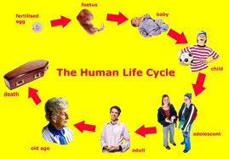
Activity

Slide 3
Activity Life Cycle
onCreate(): Called when the activity is first created. This is where you should do all of your normal static set up.
onRestart(): Called after your activity has been stopped, prior to it being started again.
onStart() Called when the activity is becoming visible to the user.

Slide 4
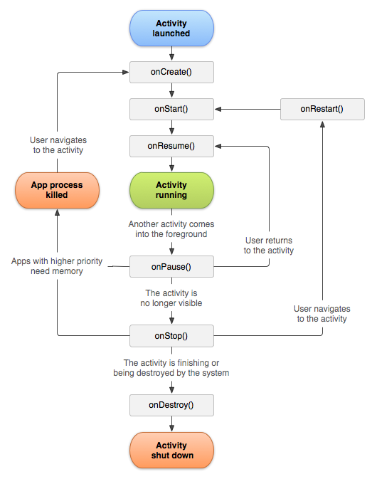

Slide 5
Activity Life Cycle
onResume(): Called when the activity will start interacting with the user. At this point your activity is at the top of the activity stack, with user input going to it.
onPause(): Called when the system is about to start resuming a previous activity. This is typically used to commit unsaved changes to persistent data.
onStop() Called when the activity is no longer visible to the user, because another activity has been resumed and is covering this one.

Slide 6
Activity Life Cycle
onDestroy(): The final call you receive before your activity is destroyed. This can happen either because the activity is finishing (someone called finish() on it, or because the system is temporarily destroying this instance of the activity to save space.
The entire lifetime of an activity happens between the first call to onCreate() through to a single final call to onDestroy().

Slide 7
Activity Life Cycle
Thank you !!!

